Slide 1
Chem 108: Lab
Week 15
Sign in
Pick up Papers
Choose 2-3 partners for today’s experiments

Slide 2
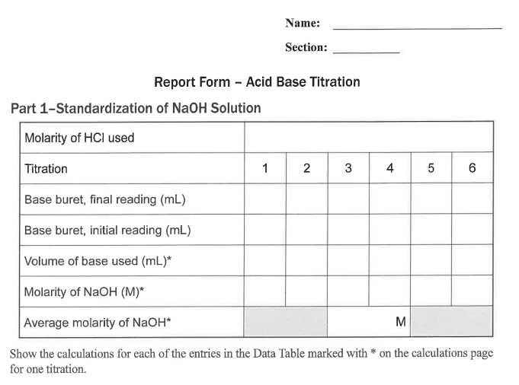
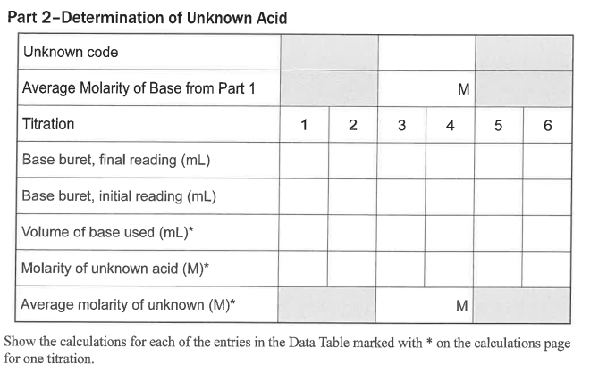
Chem 108: Lab
Due Today:
Acid-Base Titration
Complete Individual Report form pp.94-96.
Include
clear
calculations
with units.
0.2240 mol/L
Notes:
A 3900-year-old clay tablet, which was found in Iraq between the Tigris and Euphrates rivers, had a Sumerian poem (http://www.piney.com/BabNinkasi.html) honoring Ninkasi, the patron goddess of brewing. It contains the oldest surviving beer recipe, describing the fermentation of the carbohydrates found in bread, bappir, made from barley, honey, dates and sweet aromatic herbs. The global availability of carbohydrates and native microbes (yeasts) has led to the production of many different types of beers, ales, wines, and fruit based alcoholic beverages in many countries throughout the world. [The bottle on the left was found in Eugene, Oregon, ……. But, it dates only to 2016.]

Slide 3
Unkown Acid Neutralization
Net Ionic Equation/ Calculation
H⁺_{(aq)} + OH ⁻_{(aq)} H₂O_{(l)}
acid
base
water
  25.00 mL of M_{H+ aq}= ? (unknown acid solution) was titrated with a sodium hydroxide solution, M_{OH-}= ? 0.2162 M. It required 24.20 mL as an average of three trials which were within +/- 0.20 mL to reach a faint pink color.
?M_{H+} = [M_{OH-} x V_{OH-} / V_{H+} ] [? mol_{H+} / ? mol_{OH-}]
0.2162 mol_{OH-} x 0.02420 L_{OH-} x 1 mol_{H+}
L_{OH-} x 0.02500 L_{H+} x 1 mol_{OH-}
=
= 0.2093 M_{H+}

Slide 4
Two Experiments (Goup Based)
Selected Partner(s): Group of 3-4.
Synthesis of Aspirin (Part A ONLY)
  Lab Manual Instructions pg. 88; Report pg. 90 ONLY
  After the class completes filtering & storing the synthesized aspirin, then the second experiment can be started.
  (Do help other Groups.)
  Gas Stoichiometry
  Lab Manual Instructions pp. 53-56; Report pp. 58-60

Slide 5
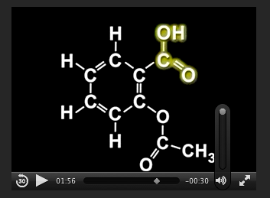
Experiment 1: Synthesis of an NSAID
(Non-steroid anti-inflammatory drug)
Aspirin
C₉H₈O₄
http://chemconnections.org/general/movies/Representations.MOV
NSAIDs are used primarily to treat inflammation, mild to moderate pain, and fever.
Notes:
Discipline-Based Education Research: Understanding and
Improving Learning in Undergraduate Science and Engineering
Susan R. Singer, Natalie R. Nielsen, and Heidi A. Schweingruber, Editors
ISBN 978-0-309-25411-3 | DOI 10.17226/13362 2012
Effective instruction involves a range of
approaches, including making lectures more interactive, having students
work in groups, and incorporating authentic problems and activities.
Students who go on to have successful careers in science or engineering
must be problem solvers, skilled in quantitative reasoning and modeling,
effective at communication and cross-disciplinary collaboration, and cognizant
of relationships between science and society (Brewer and Smith,
2011). Students who do not pursue these careers need to understand science
and engineering to serve in their roles as citizens, consumers, and leaders
of business and government who need to make wise science-informed
decisions in their personal and professional lives. Choosing healthcare for
one’s children, buying a car, voting about land-use regulations, or retrofitting
one’s house or business to be more earthquake-resistant are but a few
of the decisions that today’s undergraduates may face. Their decisions on
these and other issues will be based, in part, on their confidence in the
methods of science and engineering and their understanding of the findings
of science and engineering.
The importance of science and engineering in preparing the technical
workforce and a science-literate citizenry has drawn increased attention to
the quality of undergraduate science and engineering education and how it
can be improved. There are persistent concerns that undergraduate science
and engineering courses are not providing students with high-quality learning
experiences, nor are they attracting and retaining students in science
and engineering fields (President’s Council of Advisors on Science and Technology,
2012). Colleges and universities also face the challenge of serving
an increasingly socially, economically, and ethnically diverse undergraduate
population entering college classrooms directly from high school, after a
military career or other life experiences, or from postsecondary educational
experiences at another institution. Sustained attention to motivating, engaging
and supporting the learning of all students who enter college science
and engineering classrooms is an imperative.

Slide 6

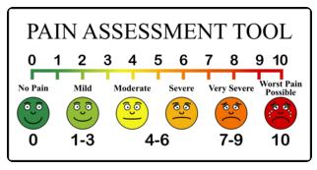
Synthesis of Aspirin
(an NSAID)
Aspirin & Pain
Used primarily to treat inflammation, mild to moderate pain, and fever.
Notes:
Discipline-Based Education Research: Understanding and
Improving Learning in Undergraduate Science and Engineering
Susan R. Singer, Natalie R. Nielsen, and Heidi A. Schweingruber, Editors
ISBN 978-0-309-25411-3 | DOI 10.17226/13362 2012
Effective instruction involves a range of
approaches, including making lectures more interactive, having students
work in groups, and incorporating authentic problems and activities.
Students who go on to have successful careers in science or engineering
must be problem solvers, skilled in quantitative reasoning and modeling,
effective at communication and cross-disciplinary collaboration, and cognizant
of relationships between science and society (Brewer and Smith,
2011). Students who do not pursue these careers need to understand science
and engineering to serve in their roles as citizens, consumers, and leaders
of business and government who need to make wise science-informed
decisions in their personal and professional lives. Choosing healthcare for
one’s children, buying a car, voting about land-use regulations, or retrofitting
one’s house or business to be more earthquake-resistant are but a few
of the decisions that today’s undergraduates may face. Their decisions on
these and other issues will be based, in part, on their confidence in the
methods of science and engineering and their understanding of the findings
of science and engineering.
The importance of science and engineering in preparing the technical
workforce and a science-literate citizenry has drawn increased attention to
the quality of undergraduate science and engineering education and how it
can be improved. There are persistent concerns that undergraduate science
and engineering courses are not providing students with high-quality learning
experiences, nor are they attracting and retaining students in science
and engineering fields (President’s Council of Advisors on Science and Technology,
2012). Colleges and universities also face the challenge of serving
an increasingly socially, economically, and ethnically diverse undergraduate
population entering college classrooms directly from high school, after a
military career or other life experiences, or from postsecondary educational
experiences at another institution. Sustained attention to motivating, engaging
and supporting the learning of all students who enter college science
and engineering classrooms is an imperative.

Slide 7
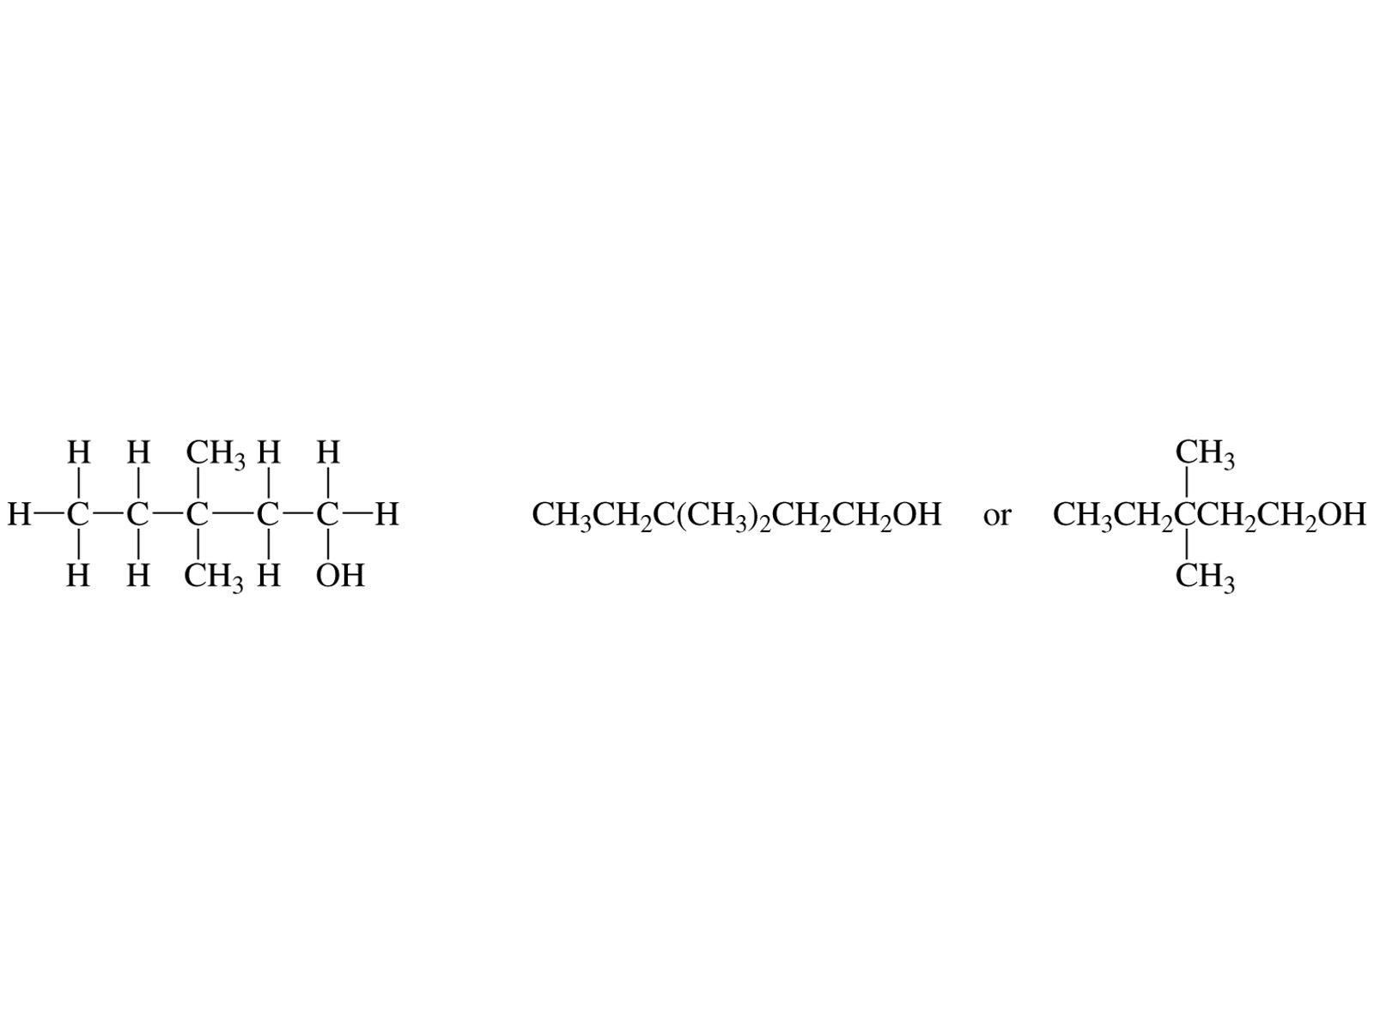
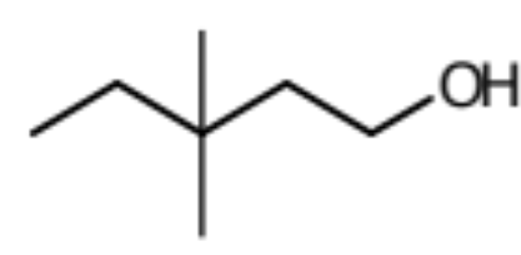
Representing Organic Molecules
Common Formulas & Drawings
Molecular formula:
C₇H₁₆O
Empirical Formula:
C₇H₁₆O
Condensed Structure:
Bond-Line Structure:

Slide 8
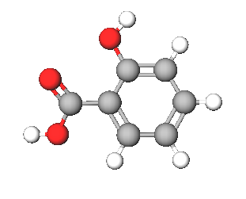
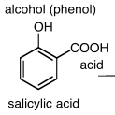
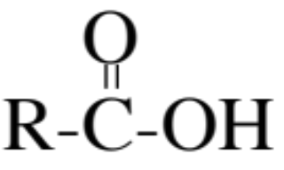
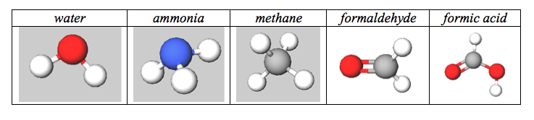
REACTANT: Salicylic Acid
Common Functional Groups
Name General Formula
Alcohols R−ΟΗ
Ethers R−Ο−R′
Amines R−ΝΗ₂
Carboxylic Acids

Slide 9
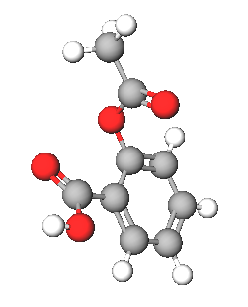
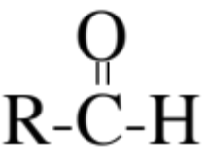
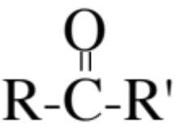
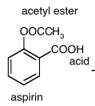
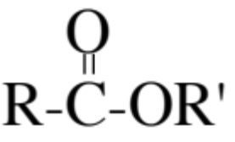
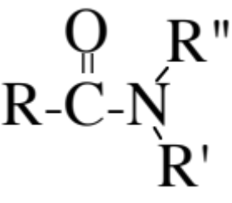
PRODUCT: Acetyl salicylic acid (aspirin)
Common Functional Groups
Name General Formula
Aldehydes
Ketones
Carboxylic Acids
Esters
Amides

Slide 10
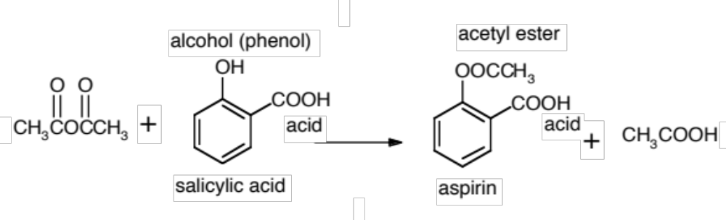
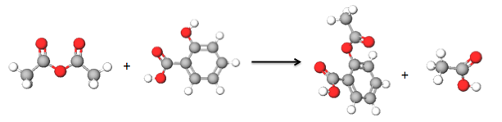
Synthesis of Aspirin
Group of 3-4.
Part A pg.88 - ONLY
acetic anhydride
H₃PO₄
acetic acid
C₇H₆O₃
C₉H₈O₄

Slide 11
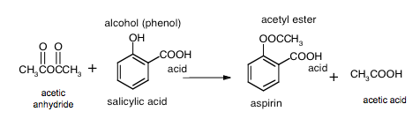
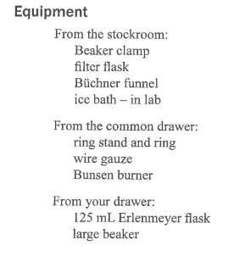
Synthesis of Aspirin
Everyone in Group is to Record Data (pg. 90 – ONLY)
H₃PO₄
C₇H₆O₃
C₉H₈O₄
Get equipment from stockroom with your group.
Follow instructions in lab manual pg.88 carefully. Be mindful of your safety. WEAR eye protection.
Store in lab drawer as instructed in Part A.3 of the instructions of the lab procedure.
Part A-4. Next Week

Slide 12
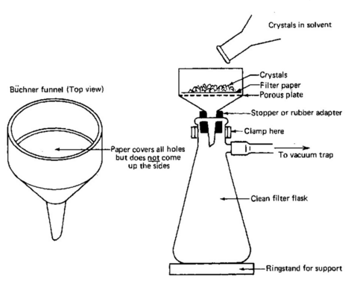
Vacuum Filtration
Store aspirin in lab drawer as instructed in Part A.3 pg. 88 of the instructions of the lab procedure.
https://www.youtube.com/watch?v=uJO_frXdNsU

Slide 13
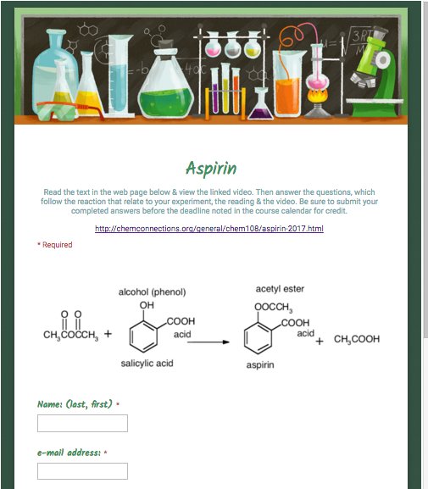
Completed Report Form & On-line Post Lab
Due next week.
http://chemconnections.org/general/chem108/Aspirin%20Guide.html
Store filtered crude aspirin in lab drawer and weigh next week.
NEXT WEEK:
Calculate % Yield.

Slide 14
TODAY:
Calculate Theoretical Yield
H₃PO₄
SA
A
grams (Salicylic Acid)
grams (Aspirin)
Using your mass of
salicylic acid
from page 90.
Moles
Molar Mass
C₉H₈O₄
MW = 180.15
Stoichiometry
grams (A)
(Molecular
? grams (SA)
1 mol (SA)
1 mol A
Weight A)
???
aspirin
? (A)
1 mol SA
grams (SA)
1 mol (A)
(Molecular
Show clearly labeled calculation with units & correct s.f ; Have pg. 90 signed before leaving lab.
Weight SA)
"Gatekeeper"
C₇H₆O₃
MW = 138.12

Slide 15
Example
H₃PO₄
SA
A
grams (Salicylic Acid)
grams (Aspirin)
Moles
Molar Mass
C₉H₈O₄
MW = 180.15
Stoichiometry
grams (A)
(Molecular
5.0 grams (SA)
1 mol (SA)
1 mol A
Weight A)
6.5 g
aspirin
? (A)
1 mol SA
grams (SA)
1 mol (A)
(Molecular
Weight SA)
"Gatekeeper"
C₇H₆O₃
MW = 138.12

Slide 17
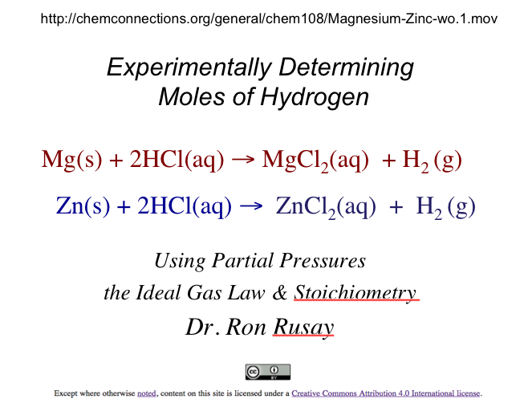
Experiment 2:
Gas Stoichiometry

Slide 18
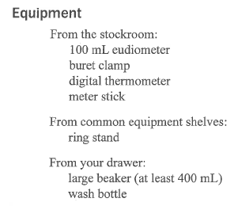
Refer to the Procedure section pp. 53-57. The following slides correspond to the instructions in the procedure.

Slide 19
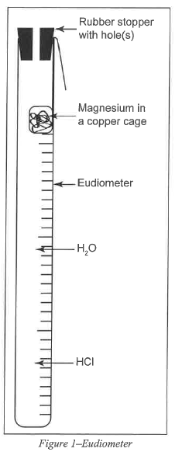
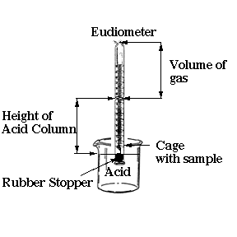

Slide 20
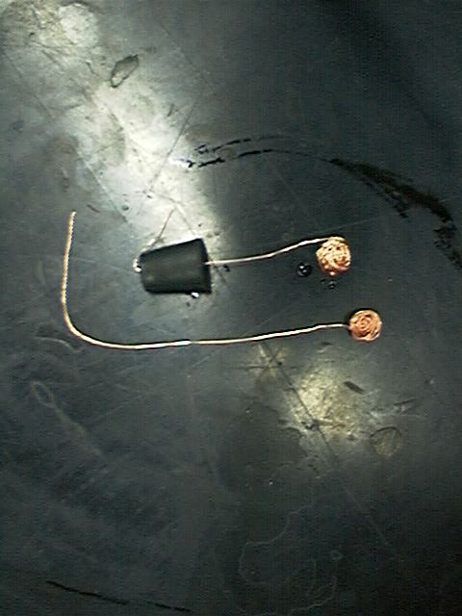
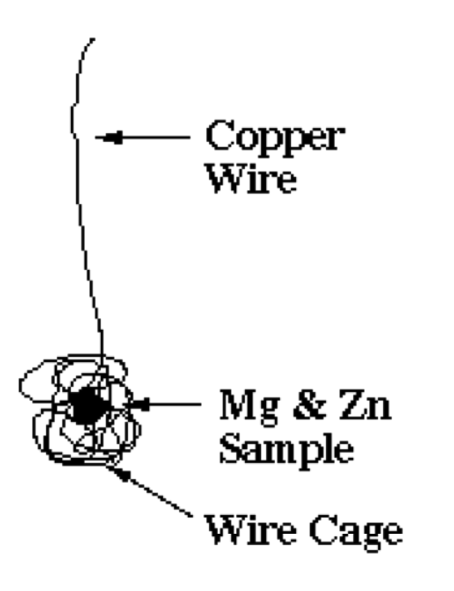
What is wrong with this set up?
Mg or Zn
Mg or Zn

Slide 21
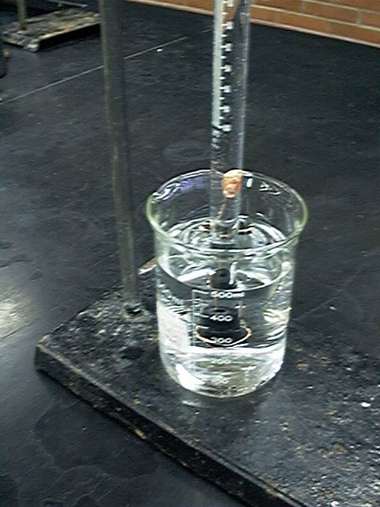
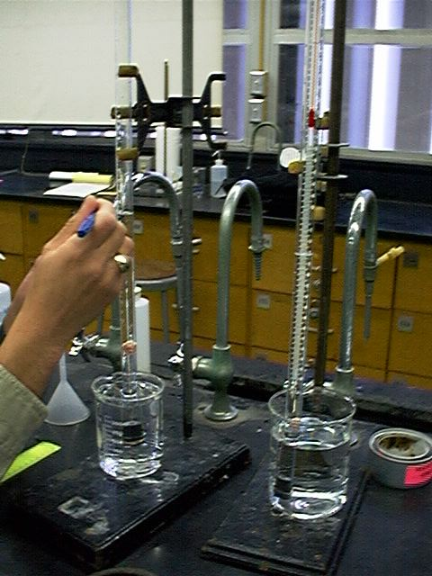
Mg(s) + 2HCl(aq) → MgCl₂(aq) + H₂ (g)
Zn(s) + 2HCl(aq) → ZnCl₂(aq) + H₂ (g)

Slide 22
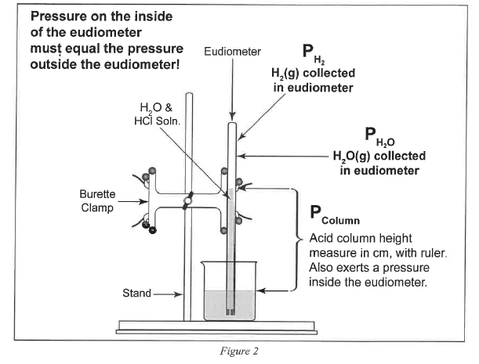
Mg or Zn

Slide 23
Refer to the Gas Stoichiometry Report Form, pg. 58-59
Experimental data is to be obtained for the reaction of a known mass of magnesium metal:
The volume of hydrogen, pressure and temperature determined and recorded.
Moles of hydrogen is calculated using Ideal Gas Law calculations, then calculating mass of the starting magnesium from the number of moles of hydrogen.
Mg(s) + 2HCl(aq) → MgCl₂(aq) + H₂ (g)

Slide 24
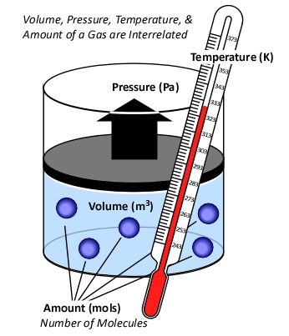
Background
Ideal Gas Law
PV = n RT
R = “proportionality” constant
  = 0.08206 L atm Κ⁻¹ mol⁻¹
P = pressure of gas in atm
V = volume of gas in liters
n = moles of gas
T = temperature of gas in Kelvin

Slide 25
Standard Conditions
Temperature, Pressure & Moles
“STP”
For 1 mole of a gas at STP:
P = 1 atmosphere
T = 0°C (273.15 K)
The molar volume of an ideal gas is 22.42 liters at STP

Slide 26
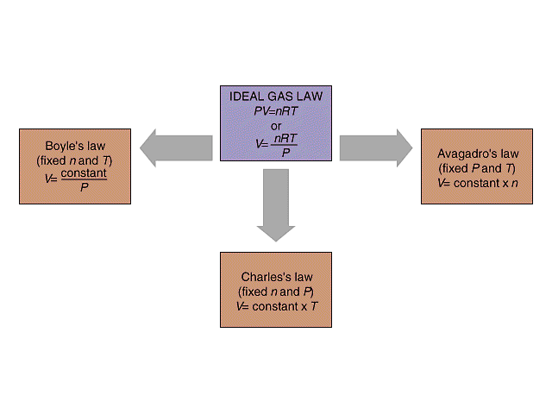
Isobaric process: pressure constant
Isochoric process: volume constant
Isothermal process: temperature constant
P₁ V₁ = P₂ V₂
P V
V₁ / n₁ = V₂ / n₂
V n
Standard Conditions (STP)
273 K, 1.0 atm,
R = 0.08206 L atm/ K mol
@STP
1 mole of any “ideal” gas has
a volume of 22.4 Liters.
Combined Gas Law
P₁V₁ / T₁ = P₂V₂ / T₂
V₁ / T₁ = V₂ / T₂
V T

Slide 27
Hydrogen & the Ideal Gas Law
n H₂(g) = PV / RT
n = moles H₂(g)
P H₂(g) = pressure of H₂(g) in atm (mm Hg → atm)
V = experimental volume (mL→ L)
T = experimental temperature (ºC → K)
Mg(s) + 2HCl(aq) → MgCl₂(aq) + H₂ (g)
Zn(s) + 2HCl(aq) → ZnCl₂(aq) + H₂ (g)

Slide 28
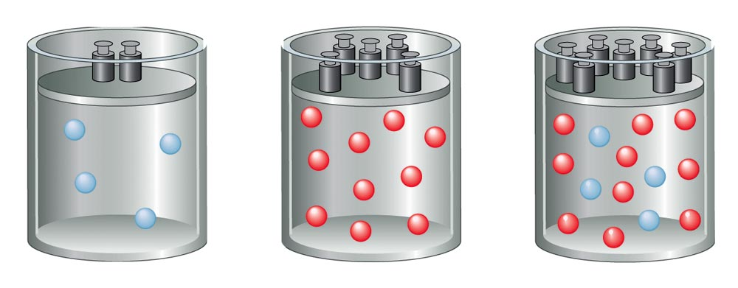
Total Pressure:
Sum of the Partial Pressures
For a mixture of gases, the total pressure is the sum of the pressures of each gas in the mixture.
  P_{Total} = P₁ + P₂ + P₃ + . . .
P_{Total} ∝ n _{Total}
n_{Total} = n₁ + n₂ + n₃ + . . .

Slide 29
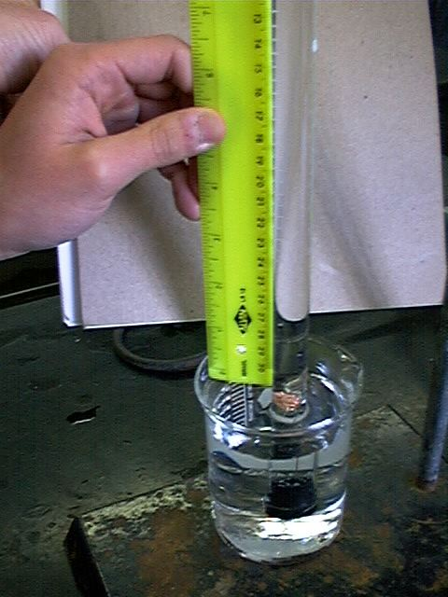
P H₂(g) = P Total (barometric) - P H₂O (g) [TABLE] - P HCl (g)
P HCl (g) =
HCl Height (mm) ÷ 12.95
___________
Density Hg is 12.95 times > density HCl(aq)
P HCl (g) =
HCl Height (mm) x 0.0772
___________
Density Hg is 12.95 times > density HCl(aq)
0.772 mm Hg/cm of acid solution

Slide 30
Ideal Gas Law:
Moles / Avogadro’s Law
n H₂(g) = PV / RT
n = moles H₂(g)
P H₂(g) = pressure of H₂(g) in atm (mm Hg → atm)
P H₂(g) = P Total (barometric) - P H₂O (g) [TABLE] - P HCl (g)
V = experimental volume (mL→ L)
T = experimental temperature (ºC → K)
R = 0.082057338 L atm K⁻¹ mol⁻¹ (constant)
Mg(s) + 2HCl(aq) → MgCl₂(aq) + H₂ (g)
Zn(s) + 2HCl(aq) → ZnCl₂(aq) + H₂ (g)

Slide 31
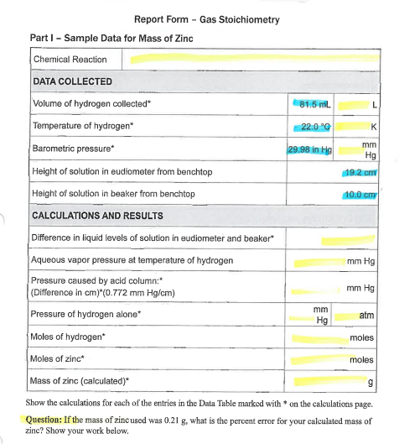
Refer to Report Form Part I pg. 58: (Example uses Zinc.)
Mole Calculations:
Stoichiometry Calculation
Ideal Gas Law Calculations
Comparison (% Error)
Everyone in the Group is to complete Part I and Part II pp. 58-60
Zn(s) + 2HCl(aq) → ZnCl₂(aq) + H₂ (g)

Slide 32
Stoichiometry
Moles Hydrogen / Mass of Zinc
(Part I: Zinc Calculation)
Zn(s) + 2HCl(aq) → ZnCl₂(aq) + H₂ (g)
mol H₂(g) = mol Zn(s)
mass (g) Zn(s) = mol Zn(s) x Molar Mass Zn(s)

Slide 33
Zinc Example Calculation
Complete Report Form pg. 58 Part I:
Mole Calculations:
Stoichiometry Calculation
Ideal Gas Law Calculations
Comparison (% Error)
Zn(s) + 2HCl(aq) → ZnCl₂(aq) + H₂ (g)

Slide 34
Moles : Ideal Gas Law
(Part I: Zinc Calculation Example)
Zn(s) + 2HCl(aq) → ZnCl₂(aq) + H₂ (g)
n H₂(g) = PV / RT
n = moles H₂(g)
P H₂(g) = pressure of H₂(g) in atm (mm Hg → atm)
P H₂(g) = P Total (barometric) - P H₂O (g) [TABLE] - P HCl (g)
V = experimental volume (mL→ L)
T = experimental temperature (ºC → K)
R = 0.082057338 L atm K⁻¹ mol⁻¹

Slide 35
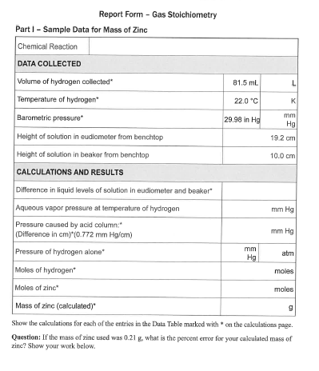
Moles : Ideal Gas Law
(Part I: Zinc Calculation Example)
Zn(s) + 2HCl(aq) → ZnCl₂(aq) + H₂ (g)
n H₂(g) = PV / RT
V = experimental volume (mL→ L)
R = 0.082057338 L atm K⁻¹ mol⁻¹

Slide 36
Moles : Ideal Gas Law
(Part I: Zinc Calculation Example)
Zn(s) + 2HCl(aq) → ZnCl₂(aq) + H₂ (g)
n H₂(g) = PV / RT
V = experimental volume (mL→ L)
T = experimental temperature (ºC → K)
R = 0.082057338 L atm K⁻¹ mol⁻¹

Slide 37
Moles : Ideal Gas Law
(Part I: Zinc Calculation Example)
Zn(s) + 2HCl(aq) → ZnCl₂(aq) + H₂ (g)
n H₂(g) = PV / RT
V = experimental volume (mL→ L)
T = experimental temperature (ºC → K)
P H₂(g) = pressure of H₂(g) in atm (mm Hg → atm)
P H₂(g) = P Total (barometric) - P H₂O (g) [TABLE] - P HCl (g)
R = 0.082057338 L atm K⁻¹ mol⁻¹

Slide 38
Moles : Ideal Gas Law
Part I: Hydrogen Calculation, (Refer to Form’s Data)
Zn(s) + 2HCl(aq) → ZnCl₂(aq) + H₂ (g)
n H₂(g) = PV / RT
n = moles H₂(g)
P H₂(g) = pressure of H₂(g) in atm (mm Hg → atm)
P H₂(g) = 29.98 inches Hg (barometric) - 19.8 mm Hg H₂O (g) [TABLE] - P HCl (g)
P HCl (g)
R = 0.082057338 L atm K⁻¹ mol⁻¹
19.2 cm
10.0 cm

Slide 39
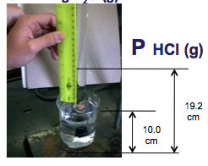
P H₂(g) = P Total (barometric) - P H₂O (g) [TABLE] - P HCl (g)
P HCl (g) =
19.2 cm Hg - 10.0 cm Hg = 92 mm HCl
HCl Height (mm) x 0.0772
= 7.10 mm Hg
__________
Density Hg is 12.95 times > density HCl(aq)
P HCl (g)
P HCl (g) =
19.2 cm Hg - 10.0 cm Hg = 92 mm HCl
HCl Height (mm) ÷ 12.95
= 7.10 mm Hg
___________
Density Hg is 12.95 times > density HCl(aq)
0.772 mm Hg/cm of acid solution

Slide 40
P H₂(g) = 761.5 mm Hg (barometric)
- 19.8 mm Hg H₂O (g) - 7.1 mm Hg HCl (g)
= 734.6 mm Hg
= 734.6 mm Hg / 760.0 mm Hg / 1.000 atm
= 0.9666 atm

Slide 41
Moles : Ideal Gas Law
(Part I: Hydrogen Calculation)
Zn(s) + 2HCl(aq) → ZnCl₂(aq) + H₂ (g)
n H₂(g) = PV / RT
n = moles H₂(g)
P H₂(g) = 0.9666 atm
V = 0.0815 L
T = 295.1 K
R = 0.08206 L atm K⁻¹ mol⁻¹
n H₂(g) =
0.00325 moles H₂(g)
= 0.00325 moles Zn(s)

Slide 42
% Error
Theoretical Mass Zinc vs. Experimental
(Part I: Calculation)
Zn(s) + 2HCl(aq) → ZnCl₂(aq) + H₂ (g)
mass (g) Zn(s) = mol Zn(s) x Molar Mass Zn(s)
= 0.00325 moles Zn(s) x 65.37 g/mol Zn(s)
experimental grams Zn(s) - theoretical grams Zn(s)
_________________________________________________________________________________________________________--________________
theoretical grams Zn(s)
% Error =
x 100
0.213 g - 0.21 g
___________________________________________________
0.21 g
=
x 100
= 1.4 %
Bring completed Report Forms to Dr. R. to get Mg(s) sample(s).

Slide 43
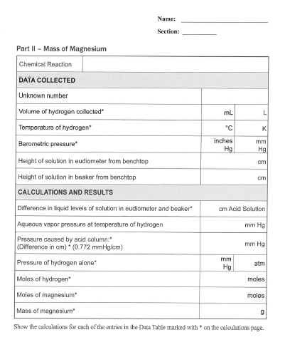
(Part II) Magnesium
Mole Calculations:
Stoichiometry Calculation
Ideal Gas Law Calculations
Comparison (% Error)
Mg(s) + 2HCl(aq) → MgCl₂(aq) + H₂ (g)
Get equipment from stockroom and complete data acquisition for Part II.
Have individual Report Forms checked before leaving lab today.

